Slide 1
Reference vs Primitive Values in JavaScript

Slide 2
Outlines
Stacks vs Heaps
Primitive vs Non-Primitive
What is Primitive
What is Non-Primitive

Slide 3
Stack vs Heap
Stack is more Protected and Safer, but smaller
Heap is a dynamic allocated that store big junk of information
Primitive are stored in the Stack
Non-Primitive (Reference) are stored in the Heap
Notes:
- A stack is usually a continuous region of memory allocating local context for each executing function
- Heap is a much larger region storing everything allocated dynamically.

Slide 4
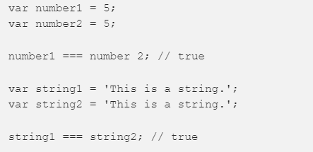
Primitive vs Non-Primitive
What is actually happening here?
https://jsbin.com/rucufaw/edit?js,console
We can see that some values change, and other doesn’t even if we change them.
Immutable vs Mutable
Notes:
- The fundamental difference between primitives and non-primitives is that primitives are immutable and non-primitives are mutable.
- Mutable data types can be changed after it gets created, immutable can’t

Slide 5
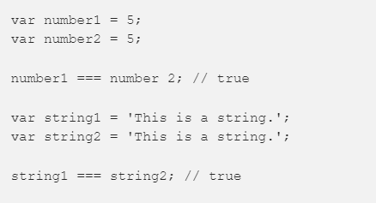
Primitive Values
DataTypes:
String: an array of characters i.e words
Number: integers, floats, etc
Boolean: true or false
Undefined: a declared variable but hasn’t been given a value
Null: no value
ES6 Symbol
They are Immutable
Stored in Stack
Objects are compared by exact value
Notes:
We need to understand where are primitive data actually stored. First of all, primitivity data are stored in the stack.
Primitives are known as being immutable data types because there is no way to change a primitive value once it gets created.
Primitives are compared by value. Two values are strictly equal if they have the same value.

Slide 6
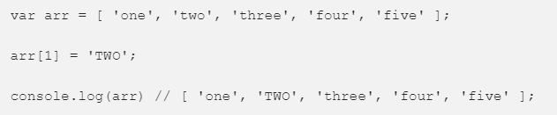
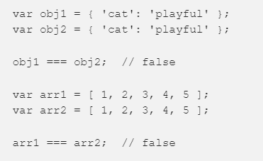
Non-Primitive
Data Types:
Array
Object
They are Mutable
Stored in Heap
Objects are not compared by value
Notes:
- Non-primitive values are mutable data types. The value of an object can be changed after it gets created. The are stored in the Heap
- Objects are not compared by value. This means that even if two objects have the same properties and values, they are not strictly equal. Same goes for arrays. Even if they have the same elements that are in the same order, they are not strictly equal.
- Non primitive values can also be referred to as reference types because they are being compared by reference instead of value. Two objects are only strictly equal if they refer to the same underlying object.
- Objects are not compared by value. This means that even if two objects have the same properties and values, they are not strictly equal. Same goes for arrays. Even if they have the same elements that are in the same order, they are not strictly equal.

